Slide 1
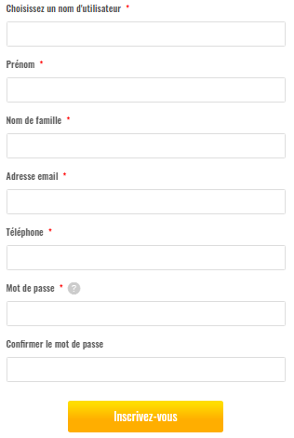
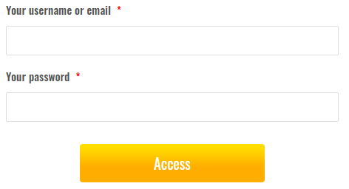
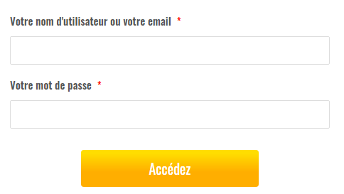
Login/Signup Screen for Free User Section
https://www.jedeposemonbilan.com/mes-dcp/
Signup new user
Existing User, access your account
As registration will complete, user will receive a welcome email with username and sitelink
Signup form have validation for unique username, password strength etc.
Redirect to DCP-form

Slide 2
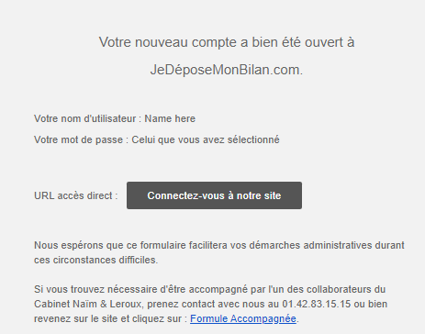
Email sent to user after signup with site link –

Slide 3
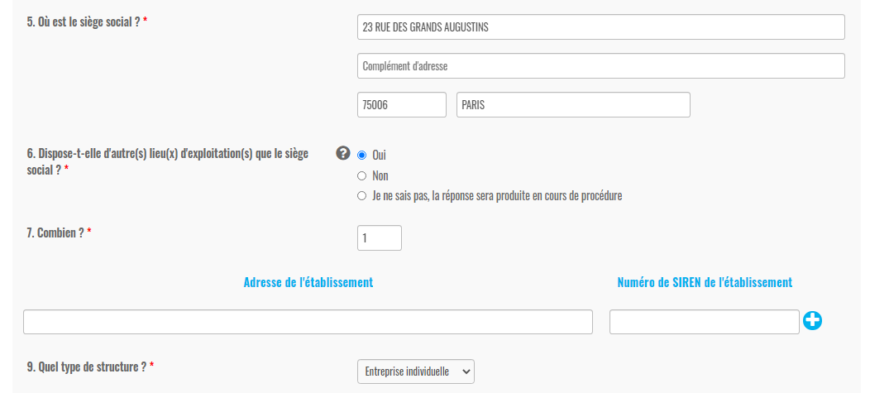
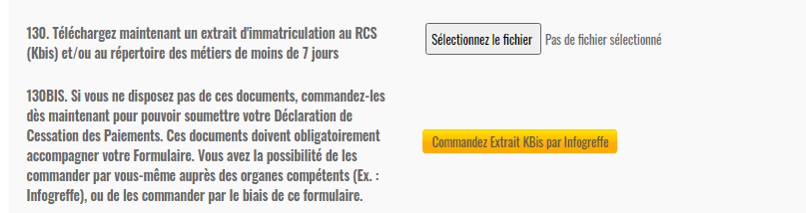
DCP Form –
There are about 140 fields in the form. And fields are working with logical condition to show their respective fields.
And the form is divided into seven screens
Form has all type of fields (input fields, radio button, file upload button ) as per need

Slide 4
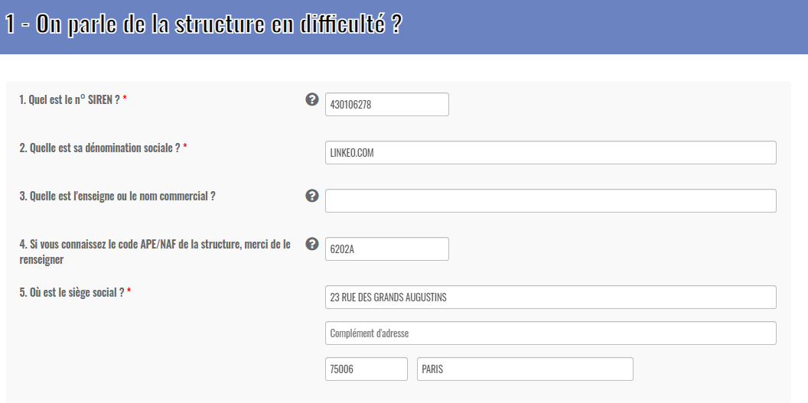
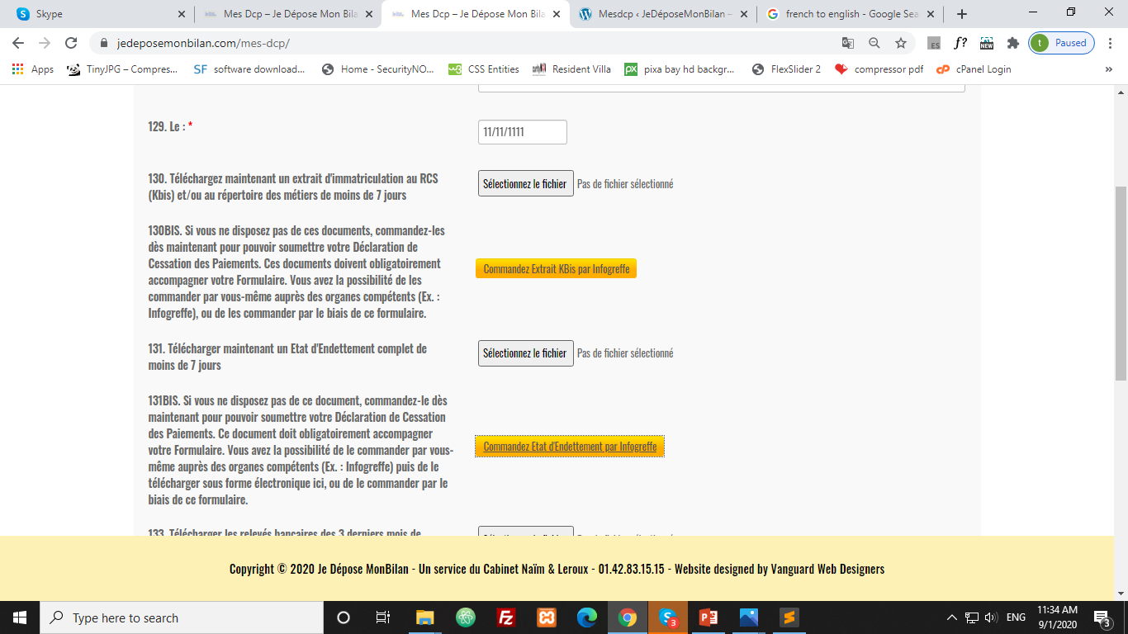
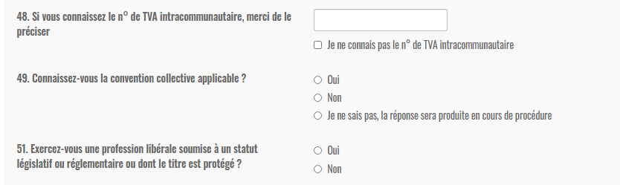
Form first screen –
1. On parle de la structure en difficulté ?
As client will enter Siren no, these respective fields will be changed
Links for these field will change as well as change the siren no
There are about 55 fields in first screen with few dynamic tables.
The siren no field is working with Infogreffe API.

Slide 5
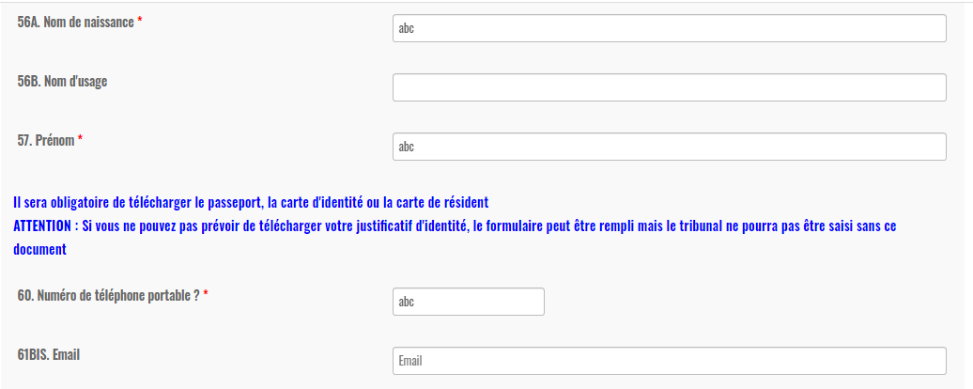
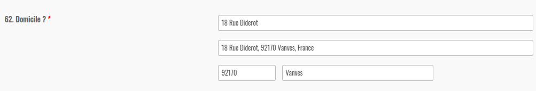
Form second screen –
2. On parle du représentant légal de la structure ?
In this screen, client need to fill personal details
Here for the address field, user need to enter the street address
And Google Maps API will detect several possibilities and user would just have to select one of the possibilities and all other address fields will automatically filled out

Slide 6
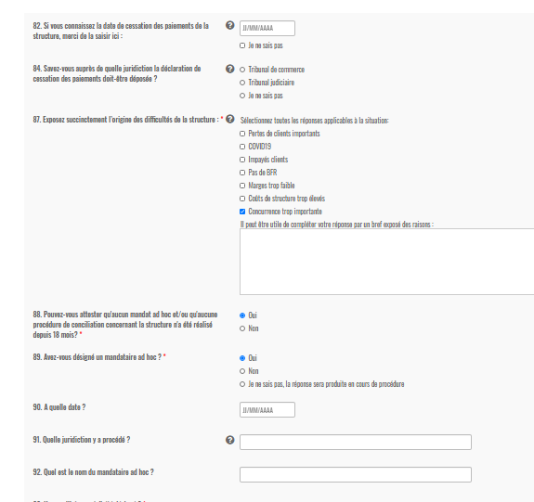
Form third screen –
3. On parle de la cessation des paiements ?

Slide 7
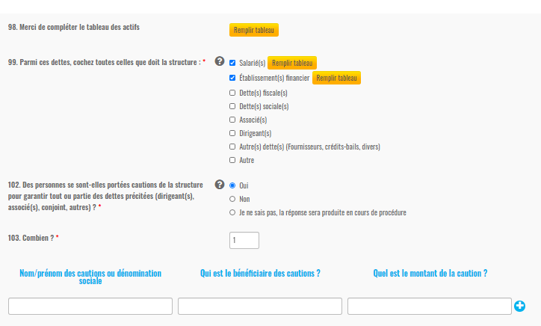
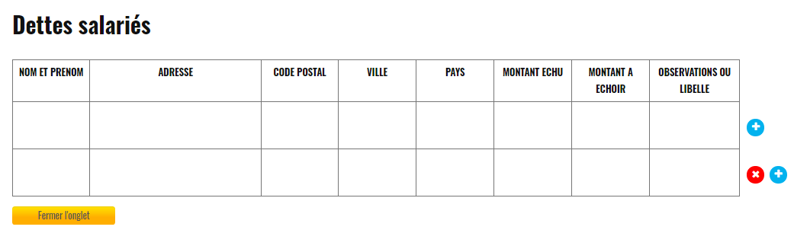
Form fourth screen –
4 - On parle de l'actif et du passif de la structure ?
As user will check the field, a button will show to open the respective table with the checkbox.

Slide 8
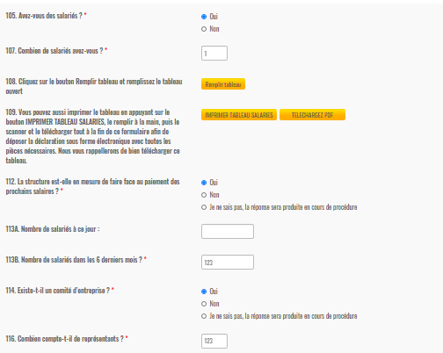
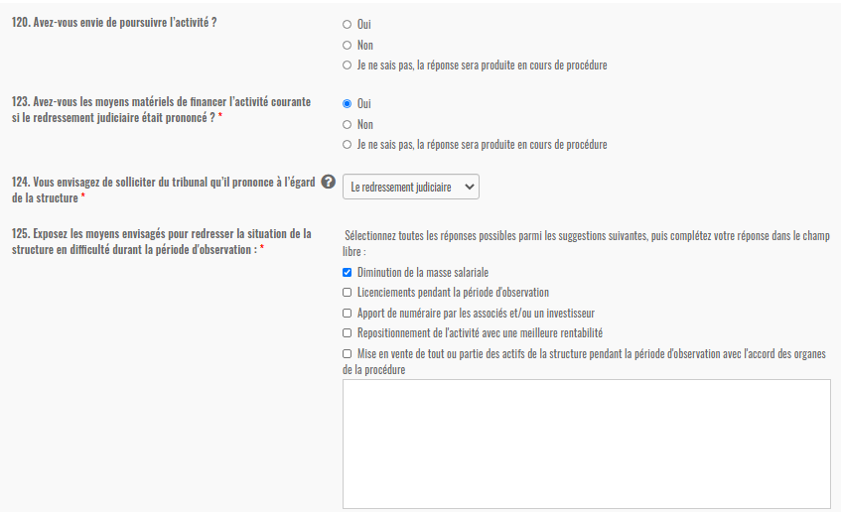
Form fifth screen –
5 - On parle des salariés ?
On this screen, user need to fill the asked info about employees
Form sixth screen –
6 - Quelle mesure demande-t-on au tribunal ?

Slide 9
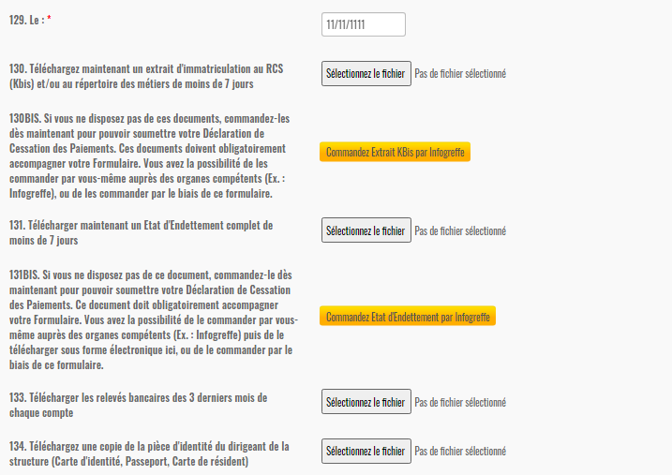
Form seventh screen –
7 - Liste des pièces à produire
In seventh screen, fields to upload the document or download the document

Slide 10


As the form is divided into 7 screens.
So Prev and Next buttons placed at the end of every screen,
Go to previous screen
Go to next screen
Form have three buttons at last screen –
Go to previous screen
All mandatory fields need to fill and then pdf can be download
And form status will change in dashboard
Will save form data on click
The form data will save in database and on the secured server as well
And filled fields ratio of the form will show in dashboard (Mes-Dcp Table)

Slide 11
Paid User Section Flow –
A mail will be sent with username and site link
Register Page to create account
If user exist, Login page is also available
Status will be reported on dashboard
Thank You message and redirect to mobile number authentication Page
Stripe Form for payment
As docs will be signed, status will be reported on dashboard
Link to sign legal docs
Thank You message and link to DCP Form

Slide 12
Login/Signup screen for paid user section
https://www.jedeposemonbilan.com/mes-dcp-paid/
Signup new user
Existing User, access your account
As registration will complete, user will receive a welcome email with username and sitelink.
Signup form have validation for unique username, password strength etc.
Redirect to Stripe Form

Slide 13
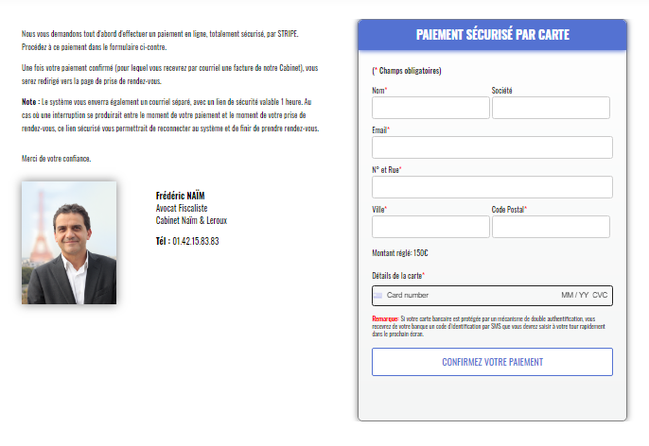
Stripe Payment Page –
Client needs to fill the details and click on submit to pay
On successful payment, client will redirect to next page for mobile authentication
And status will update on dashboard in Mes-dcp table

Slide 14
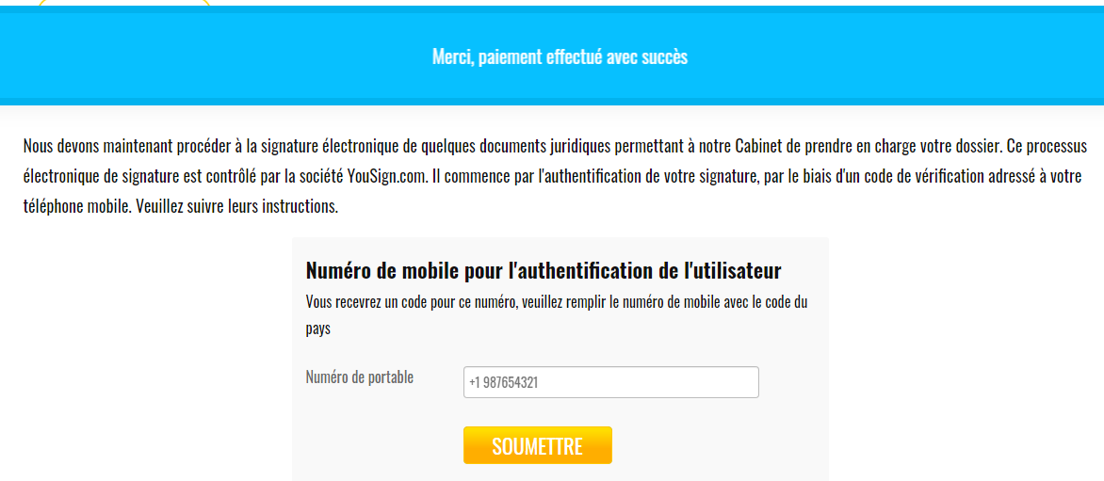
Mobile Authentication Page –
Client need to fill the mobile number with the country code
And later will receiver a code on this number to authenticate the mobile number.
On submit will redirect to YouSign Page to sign the legal docs

Slide 15
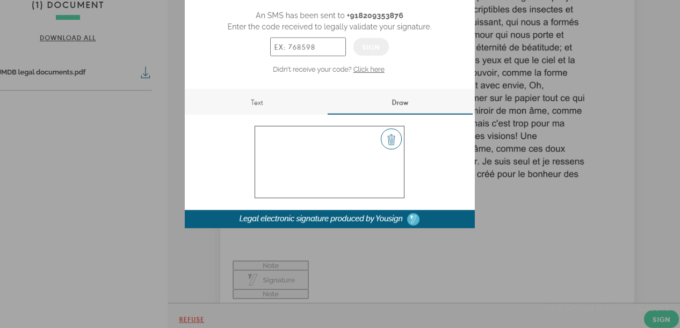
YouSign Page –
Client have to read full doc and then click on the SIGN button
On click the SIGN button, this popup will show
Client have to authenticate the number and will allow to sign the doc
As docs will be signed, the status will be reported on dashboard

Slide 16
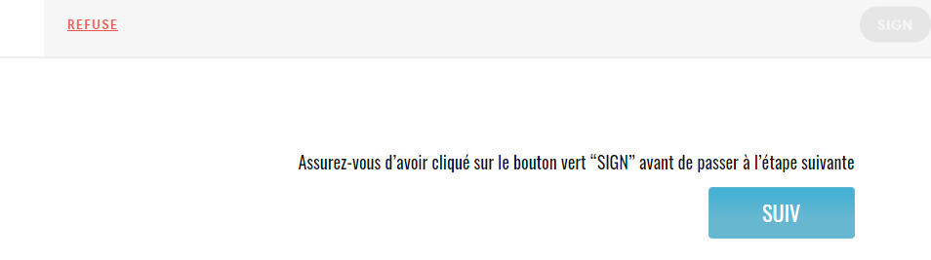
A Next button placed at the end of YouSign Page
On click the Next button, will redirect to Mes-Dcp Form
Will open DCP Form And client need to fill the form
Form will auto save after a fix time interval

Slide 17
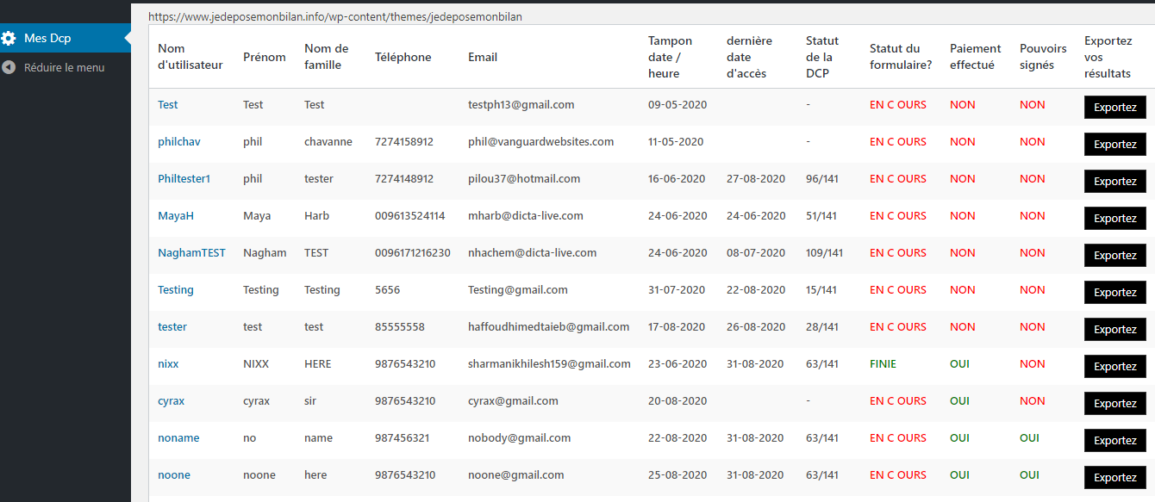
Mes-Dcp Table on the secure Site –
All progress will be shown here to the lawyer or admin.
Last access date of the DCPForm
Export Button to download the DCP form pdf of respective user
Filled questions ratio of DCP Form
If payment has done for paid users, the status will be changed here to OUI
As docs will be signed, status will be change to OUI for respective user
If all the mandatory fields filled and click on submit button in DCP Form

